Slide 1

What’s new in ASP.NET Core 3.0
Scott Addie
@Scott_Addie

Slide 2


.NET Framework unsupported
WebApp.csproj
<Project Sdk="Microsoft.NET.Sdk.Web"> <PropertyGroup> <TargetFramework>netcoreapp3.0</TargetFramework> </PropertyGroup> </Project>
Notes:
ASP.NET Core 3.0 built on .NET Standard 2.1
.NET Standard is first version to NOT support .NET Framework

Slide 3
Supported ASP.NET Core variants
3.0 on .NET Core 3.0
2.2 on .NET Core 2.2
2.1 on .NET Core 2.1
2.1 on .NET Framework 4.6.x
Current
Maint.
LTS
LTS
Notes:
3.1 = LTS

Slide 4
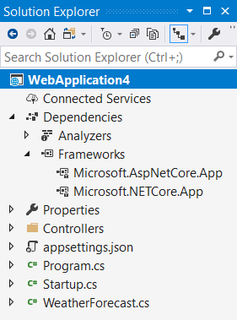
Implicit Shared Framework reference
Web SDK includes the following:
<ItemGroup>
<FrameworkReference Include="Microsoft.AspNetCore.App" />
</ItemGroup>
Remove metapackage reference when migrating:
<ItemGroup>
<PackageReference Include="Microsoft.AspNetCore.App" />
</ItemGroup>

Slide 5

Episode III
A NEW RELEASE
It is a period of assembly removal from the ASP.NET Core shared framework. Caffeinated engineers, working from a building in Redmond, have made tough decisions…
Notes:
Remove things the ASP.NET Core team doesn’t own:
Azure SDK
EF Core

Slide 6

Assemblies removed from Shared Framework
Json.NET
Microsoft.AspNet.WebApi.Client
Roslyn (Microsoft.CodeAnalysis.*)
EF Core
Social auth
Node Services & SPA Services
Notes:
WebApi.Client: had a dependency on Json.NET
Roslyn:
ships on the VS schedule, which differs from the .NET Core release lifecycle
some customers don’t want compilers in there for security reasons
Social auth: Facebook, Google, Microsoft, Twitter

Slide 7
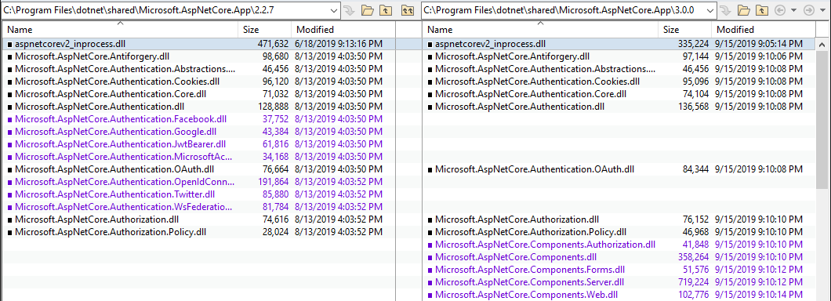
Shared Framework: 2.2 vs. 3.0

Slide 8
C# 8 support
[HttpGet("asyncsale")]
public async IAsyncEnumerable<Product> GetOnSaleProductsAsync()
{
var products = _repo.GetProductsAsync();
await foreach (var product in products)
{
if (product.IsOnSale)
{
yield return product;
}
}
}
Notes:
GetProductsAsync returns an IAsyncEnumerable<Product>
This is a non-blocking action as of 3.0
MVC buffers any concrete type that implements IAsyncEnumerable<T> before sending it to the serializer

Slide 9

Blazor

Slide 10
System.Text.Json

Slide 11
Endpoint routing

Slide 12
HTTP REPL
httprepl
set base https://localhost:5001
cd weatherforecast
GET Chicago

Slide 13
Developer Exception Page plain text support
[ApiController]
[Route("[controller]")]
public class WeatherForecastController : ControllerBase
{
[HttpGet("{city}")]
public WeatherForecast Get(string city)
{
if (!string.Equals(city?.TrimEnd(), "Redmond",
StringComparison.OrdinalIgnoreCase))
{
throw new ArgumentException(
$"Weather forecast unavailable for {city}.", nameof(city));
}
return GetWeather().First();
}

Slide 14
Plain-text response
cmd - httprepl
https://localhost:5001/weatherforecast> GET Chicago HTTP/1.1 500 Internal Server Error Content-Type: text/plain Date: Wed, 02 Oct 2019 01:50:48 GMT Server: Kestrel Transfer-Encoding: chunked System.ArgumentException: Weather forecast unavailable for Chicago. (Parameter 'city') at WebApplication3.Controllers.WeatherForecastController.Get(String city) in C:\Users\scaddie\source\repos\WebApplication3\Controllers\WeatherForecastController.cs:line 35 at lambda_method(Closure , Object , Object[] ) at Microsoft.Extensions.Internal.ObjectMethodExecutor.Execute(Object target, Object[] parameters)
Notes:
Plain text = default media type in 3.0

Slide 15
HTML response
cmd - httprepl
https://localhost:5001/weatherforecast> GET Chicago -h Accept=text/html HTTP/1.1 500 Internal Server Error Content-Type: text/html; charset=utf-8 Date: Wed, 02 Oct 2019 02:07:06 GMT Server: Kestrel Transfer-Encoding: chunked <!DOCTYPE html []> <html lang="en" xmlns="http://www.w3.org/1999/xhtml"> <head> <meta charset="utf-8" /> <title>Internal Server Error</title> <style> body { font-family: 'Segoe UI', Tahoma, Arial, Helvetica, sans-serif; font-size: .813em;
Notes:
Set Accept header to opt into HTML response
HTML was ONLY supported media type in < 3.0

Slide 16

gRPC
Contract-based RPC services
Messages sent/received via HTTP/2
Services & messages defined with Protobuf
Binary serialization
Notes:
Conceptually similar to WCF & .NET Remoting
We’re contributing to the open source gRPC project (https://github.com/grpc/grpc-dotnet)
In PROD, configure TLS (Transport Layer Security) to secure messages
*.proto (Protocol Buffers) files
Reduced network congestion thanks to binary serialization

Slide 17

Worker services

Slide 18

SignalR automatic reconnects

Slide 19
global.json enhancements
dotnet --roll-forward <setting>
LatestPatch
Minor
LatestMinor
Major
LatestMajor
Disable
Notes:
New roll-forward behaviors

Slide 20
Blazor + gRPC + SignalR
DEMO

Slide 21
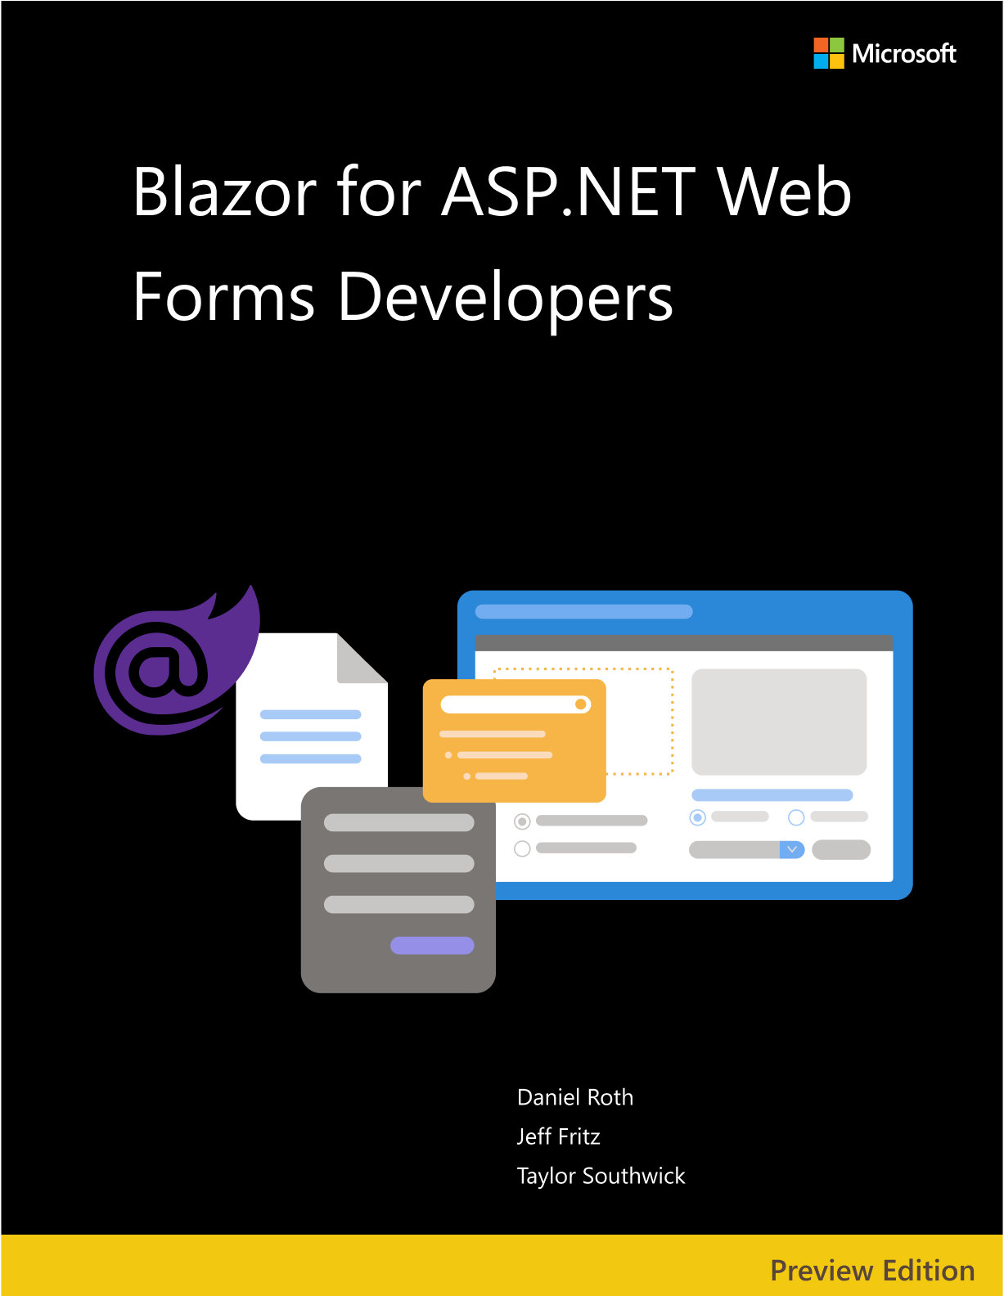


Resources
eBooks
docs.microsoft.com/dotnet/architecture/
Docs
docs.asp.net
Slides
aka.ms/new-in-aspnetcore3
Code
aka.ms/contoso-lending
Socials
@Scott_Addie

